Slide 1
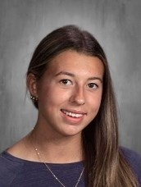
You Make AP a GREAT Place to BE!
Eleanor Baecker—Grade 10
Eleanor is a happy and kind individual.
She is also a diligent to learner; she commits her free time to fully understand material and better herself in class.
Keep it up!! Ms. Caboot

Slide 2
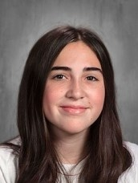
You Make AP a GREAT Place to BE!
Katherine Buttaci—Grade 10
Katie is such a breath of fresh air!
She always has a smile on her face, is eager to help out, and makes everyone feel included.
Whenever I chat with Katie, my day is truly brighter!
Katie makes AP a Great Place to BE!
Ms. Mouzakes

Slide 3
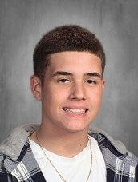
You Make AP a GREAT Place to BE!
Ronald Dawson—Grade 10
Ronnie is a leader in class.
He uses his time wisely and leads his group through labs and assignments. Ronnie is also a great artist; he is able to make creative and clear images of what we are discussing in class, and our class mascot!
Keep it up!
Ms. Caboot

Slide 4
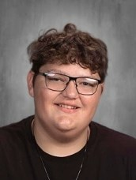
You Make AP a GREAT Place to BE!
Dominick DiNardo—Grade 10
Dominick goes out of his way to help others.
He will help a friend with assignments as well as help his teachers.
Dominick works outside of school with his family and he is involved in extracurricular activities.
He is a good role model for others. Ms. Hall

Slide 5
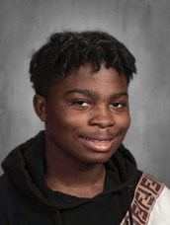
You Make AP a GREAT Place to BE!
Elijah Jefferson—Grade 10
Elijah has made tremendous improvements this school year!
He has been working hard to bring his best self to class, is an excellent self-advocate, and continues to be respectful.
Eli truly helps to make AP a great place to be!
Ms. Mouzakes

Slide 6
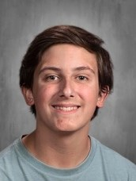
You Make AP a GREAT Place to BE!
Alexander Perala—Grade 10
Alex is a very hard working student.
He is great at following lab procedures and helping out his lab group!
Keep it up Alex!! Ms. Caboot

Slide 7
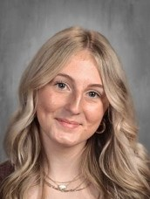
You Make AP a GREAT Place to BE!
Abigail Salsbury—Grade 10
Abby has been meeting up with her friends during advisory so they can do math together.
She encourages her classmates during class with a positive attitude and making sure they are working hard.
She makes our class a better place to be! Mrs. Agnew

Slide 8
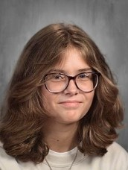
You Make AP a GREAT Place to BE!
Zoe Smith—Grade 10
I always look forward to seeing Zoe in class and advisory.
In addition to her academic efforts, she is mature, confident, and always has a pleasant demeanor. She is someone who is well liked by peers and teachers.
She is a deep thinker and a great writer.
I am so happy to have Zoe in class this year!
Mrs. Rosemarino

