Slide 1
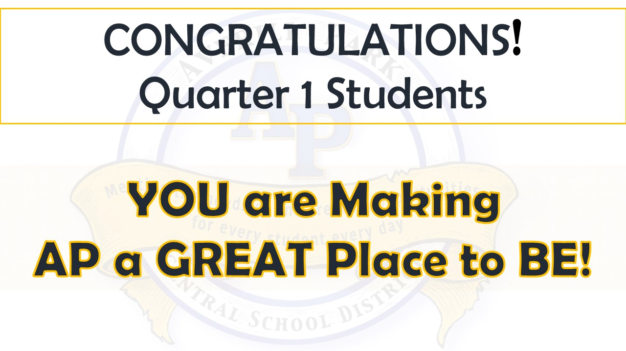

Slide 2
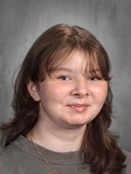
You Make AP a GREAT Place to BE!
Z Clerico—Grade 11
Z's efforts in class contribute positively to the class vibe!
Mrs. Garrison

Slide 3
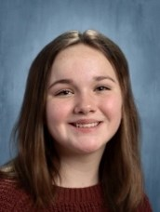
You Make AP a GREAT Place to BE! ou Make AP a GREAT Place to BE!
Morgan Heffner—Grade 11
Morgan has demonstrated great enthusiasm and initiative in chemistry.
Her positive energy and excitement make our chemistry class a great place to be! Ms. Carey

Slide 4
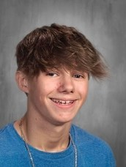
You Make AP a GREAT Place to BE!
Gavin Herald—Grade 11
Gavin is a kind classmate in the hallway. He always makes sure to say "hi" to everyone! Ms. Scheidel

Slide 5
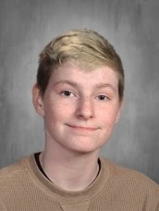
You Make AP a GREAT Place to BE!
Sam Hinman—Grade 11
For going above and beyond helping out.
Sam always has such a great positive attitude! Mrs. Sector

Slide 6
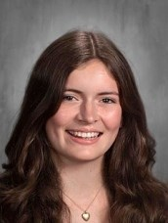
You Make AP a GREAT Place to BE!
Hazel Miller—Grade 11
Hazel is friendly and hard-working
Her contributions make class better for us all!
Ms. Garrison

Slide 7
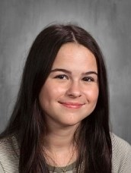
You Make AP a GREAT Place to BE!
Sophie Perrotta—Grade 11
Sophie has developed an especially strong skill and affinity for French.
She uses French to communicate with her pen pal on social media. Mr. Brown

Slide 8
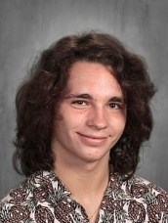
You Make AP a GREAT Place to BE!
Patrick Stawowy—Grade 11
Patrick does a tremendous amount for both band and jazz ensemble
He is always prepared, is flexible and works to help others do their best.
He always puts ensemble above himself. Mr. Blostein

Slide 9
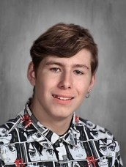
You Make AP a GREAT Place to BE!
Mason Wagner—Grade 11
Congratulations, Mason!
Your hard work and positive attitude have truly paid off.
You’ve shown kindness and friendliness to everyone around you, and it’s inspiring to see how you've given your best effort every day.
Your dedication has clearly paid off, and you should be incredibly proud of yourself. Keep up the amazing work!
Mrs. Leach
Most improved!
Mrs. Daviero

