Slide 1
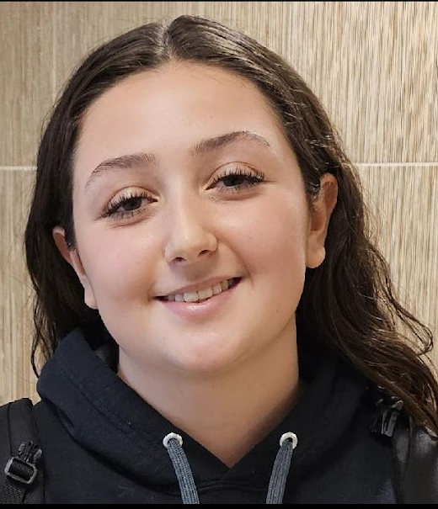
You Make AP a GREAT Place to BE!
Isabella Alvarez—Grade 10
Isabella is a hard worker and strong self advocate.
She is friendly, has a positive attitude, and is motivated to succeed.
Ms. Hotaling

Slide 2
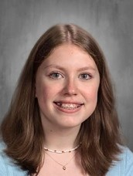
You Make AP a GREAT Place to BE!
Rebecca Gallerani—Grade 10
Rebecca frequently stops class to ask for clarification.
By doing so, her classmates benefit from the time we all take to make a concept more understandable.
Mr. Brown

Slide 3
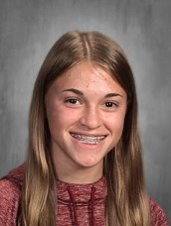
You Make AP a GREAT Place to BE!
Abigail Hurst—Grade 10
Abigail is hard working, persistent, talented and curious.
She utilizes the skills and knowledge she acquired in class to pursue her own passions & interests outside of the classroom.
Mr. Kline

Slide 4
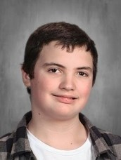
You Make AP a GREAT Place to BE!
Maxilium Marra—Grade 10
Max has been working really hard this year to do well in school.
He always has a kind word for the adults he encounters in the building.
He could give a master class on nice manners!
Mrs. Marrufo

